Slide 1
Predictive Analytics Final Project
House Price Prediction & Market Segmentation

Slide 2
Business Problem
Goal: Predict house accurately and identify distinct market segments
Why it matters: Inform buyers, sellers, agents, and investors
Key Business Question
How can we use structured data to predict house prices and segment the market more effectively?

Slide 3
Dataset Overview
Key Features Categories
AmesHousing (2930 records, 82 variables
Target Variable: SalePrice
Structural Features | Quality & Condition | Target | Age & Renovation History
Gr Liv Area | Exter Qual | Neighborhood | Year Built
Lot Area | Kitchen Qual | Condition 1 | Year Remod/Add
Overall Qual | Bsmt Cond | Lot Config | Garage Yr Blt
Total SF | Garage Finish |  | HouseAge

Slide 4
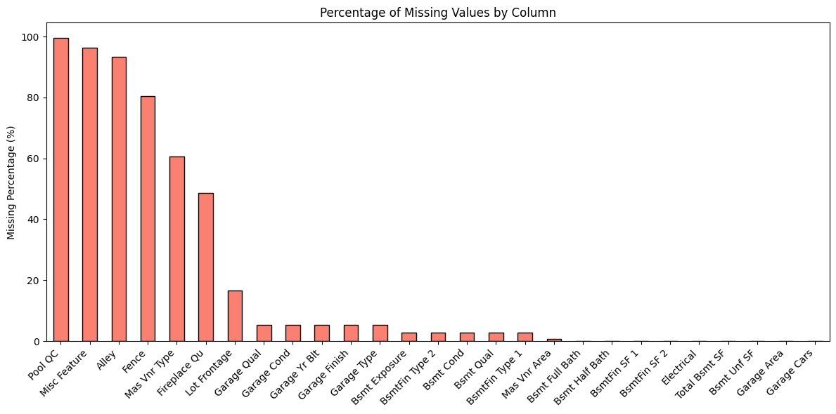
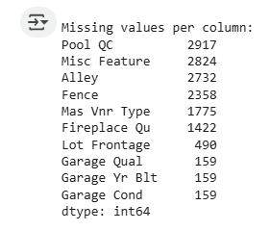

Data Cleaning & Preparation
Removed: Columns with >40% missing values (e.g., PoolQC, Alley)
Imputed:
Median for numerical
Mode for categorical
Transformed: Applied log to SalePrice & GrLivArea to fix skewness

Slide 5
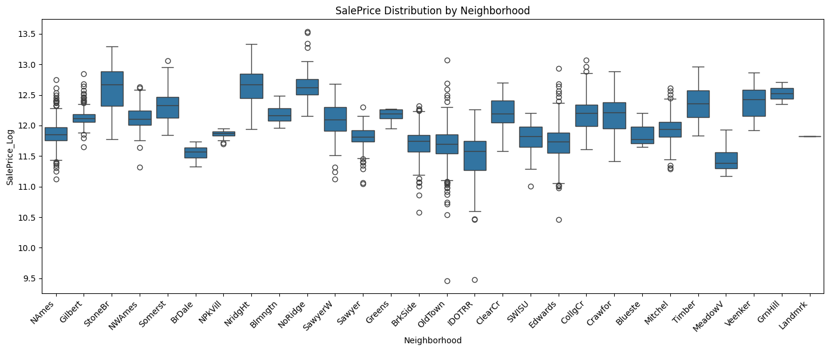
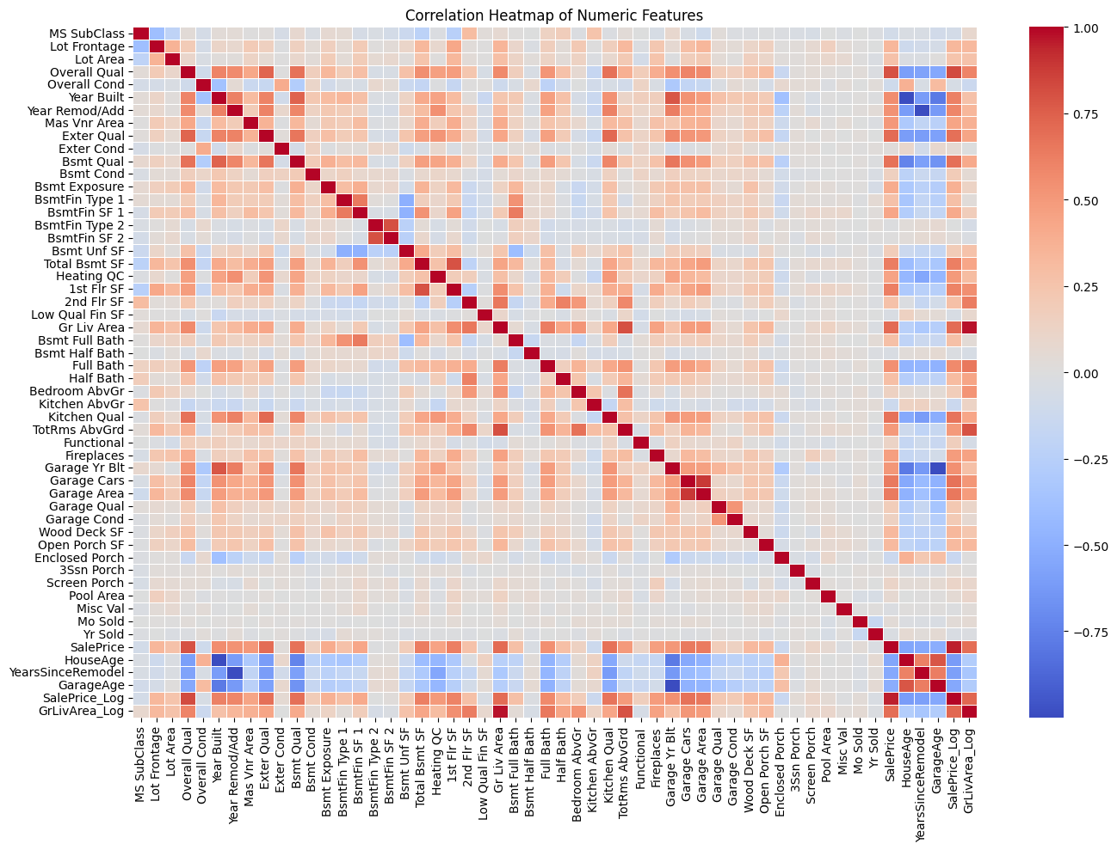
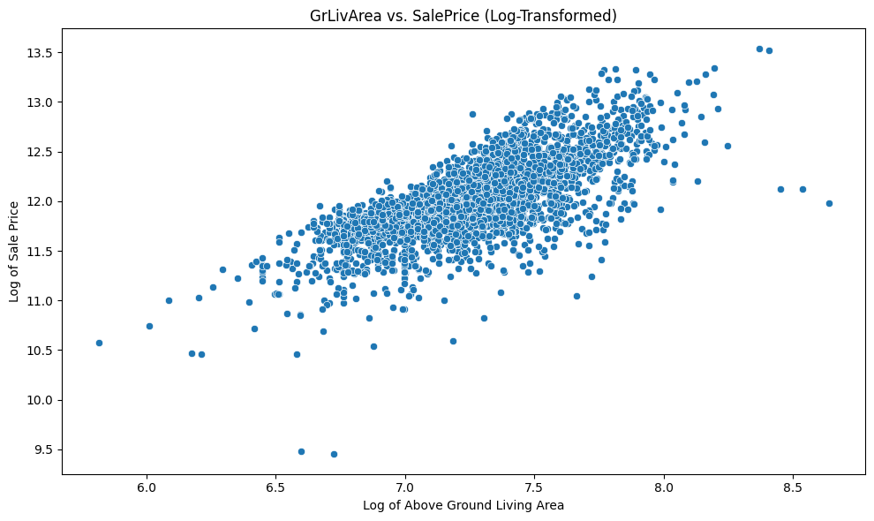
Exploratory Data Analysis
Correlation heatmap → top predictors
Boxplots → Neighborhood and HouseStyle impact on price
Scatterplot → Living area vs Price
Insight: Larger, newer, and better-located homes → higher prices

Slide 6

Feature Engineering
New Features Created:HouseAge, GarageAge, TotalBathrooms, TotalSF
Encoding:Ordinal: Quality-related featuresOne-hot: Nominal like Neighborhood
Final dataset: 2,930 rows × 207 features

Slide 7
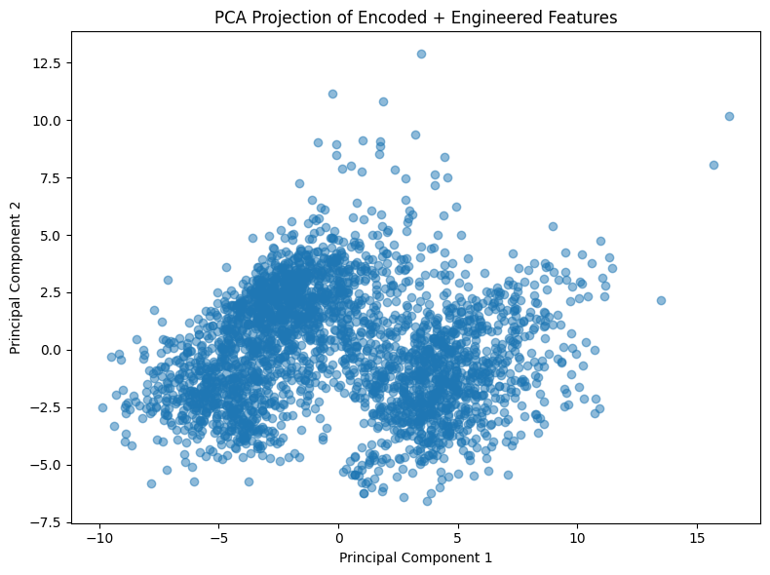
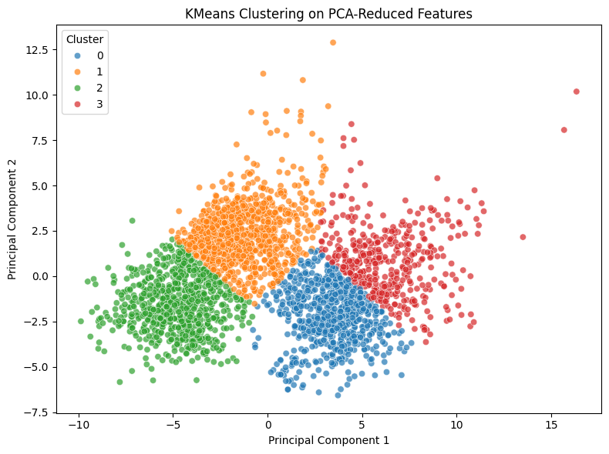
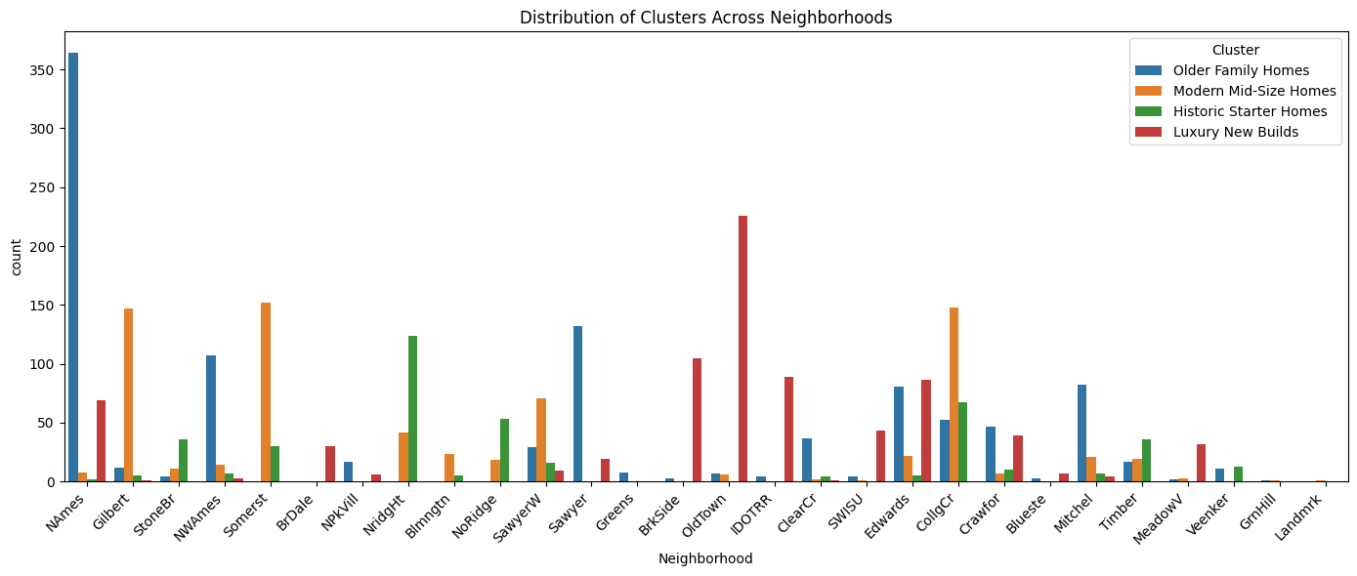
Market Segmentation(Clustering)
Technique: PCA + KMeans (4 clusters)
Cluster Types:
Modern Mid-Size
Older Family Homes
Historic Starter Homes
Luxury New Builds

Slide 8
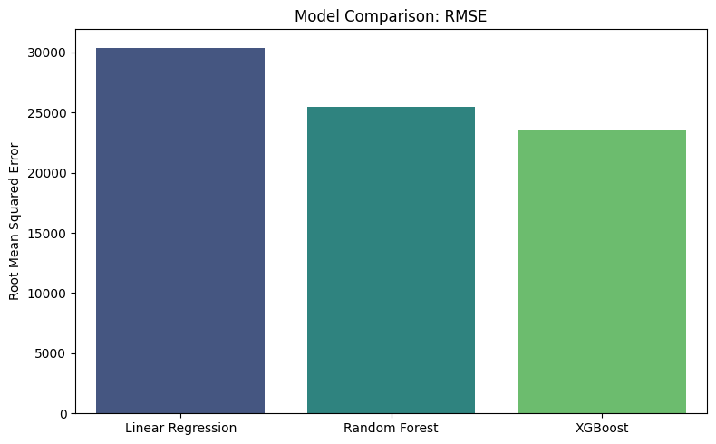
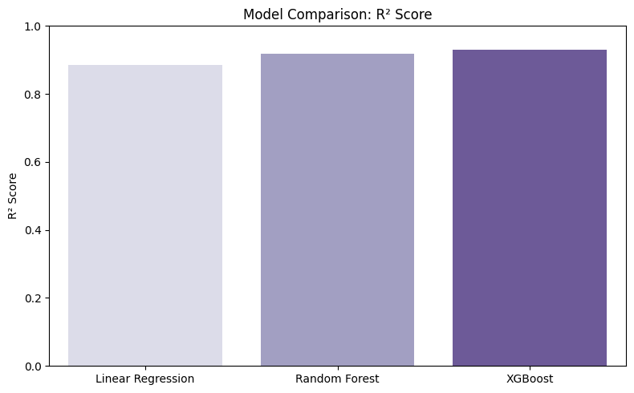
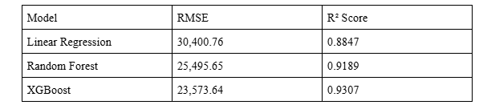
Predictive Modeling
Models used:
Linear Regression
Random Forest
XGBoost
Best Performance:
XGBoost (RMSE = 23,574 | R² = 0.9307)

Slide 9
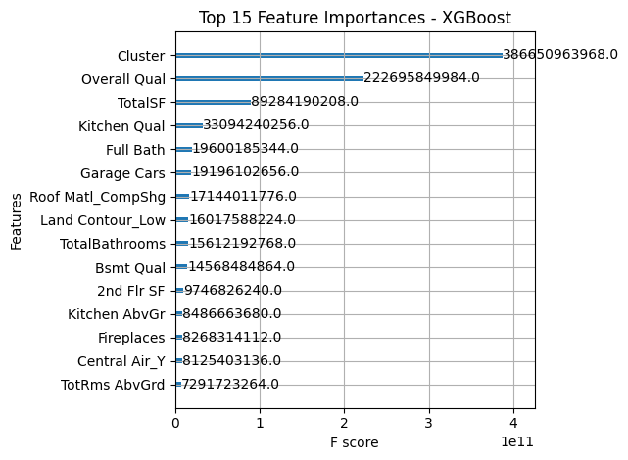
Insights & Recommendations
Top Predictors: OverallQual, TotalSF, KitchenQual, GarageCars, Cluster
Why Cluster matters: It outperformed some traditional numeric predictors
For Sellers/Agents: Improve quality & usable space
For Investors: Use market segments to guide buying decisions

Slide 10
Conclusion
Accurate Price Prediction: Achieved through XGBoost with strong performance (RMSE ≈ 23,574, R² = 0.9307)
Meaningful Market Segmentation: Identified distinct housing clusters using Kmeans and PCA for targeted analysis
Real Business Value: Enables data-driven decision-making for buyers, sellers, agents, and investors in the real estate market

